Slide 1



Understanding Our Current Business Challenges and Opportunities
Horizon Equipment Co. Timeline of Challenges and Opportunities
Exploring the impact of data issues on our quote-to-cash cycle efficiency.

Slide 2

Challenges in Quote-to-Cash
Data Inaccuracies
Operational Bottlenecks
Revenue Loss
Delayed revenue due to incorrect information
Handoffs between departments causing delays
Impact of delays on overall performance
Inaccurate data leads to lost opportunities and delays in processing.
Unreliable information during handoffs results in increased wait times for customers.
Prolonged delays directly affect cash flow and revenue generation.

Slide 3
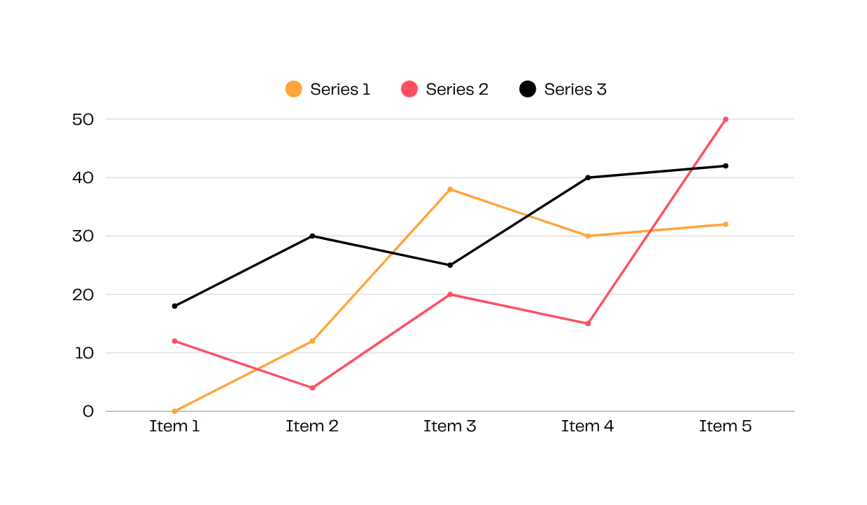

Impact of Unreliable Data in Handoffs
Understanding the challenges faced by Sales, Ops, and Finance due to data inconsistencies is crucial for operational efficiency.
Unreliable data during handoffs can lead to significant operational inefficiencies. Sales teams encounter lost opportunities when quotes are delayed, while Finance experiences financial discrepancies that hinder decision-making. Addressing these gaps is essential for smoother workflows and improved performance across departments.

Slide 4
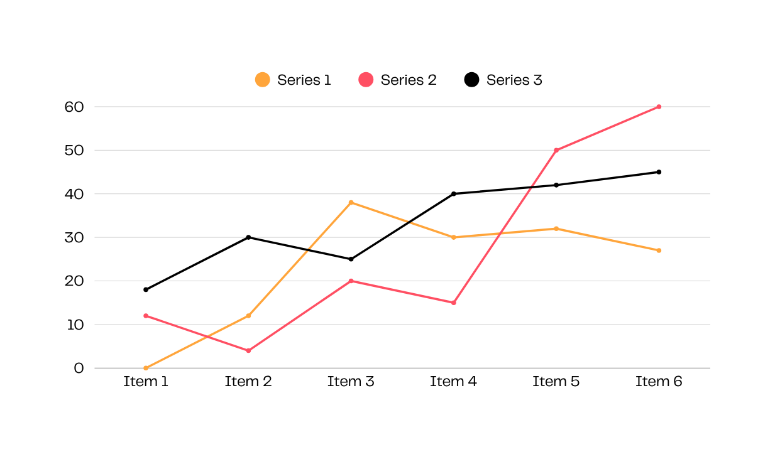
Master Data Benefits: Before and After
Understanding how standardized data can enhance efficiency and accuracy across our organization is crucial for our success.
Implementing a master data strategy has led to significant improvements. We’ve seen reduced duplicates, resulting in faster quotes and more accurate real-time inventory, ultimately driving better decision-making and enhanced operational efficiency across departments.

Slide 5

90-Day Quick Wins Roadmap
Initial Assessment
Standard-ization
Tool Selection
Progress Review
Evaluate current processes and identify key gaps
Implement data standards across departments
Choose essential tools for efficiency improvement
Analyze results and gather feedback for adjustments
Review existing workflows to highlight immediate improvement areas.
Create a framework for consistent data usage across all teams.
Select and deploy tools that enhance workflow and data accuracy.
Conduct weekly reviews to ensure alignment with goals and progress.

Slide 6

Action Items for Leadership Support
Responsible Executives
Assigning clear roles ensures accountability and effective execution of plans.
SME Approval
Gaining buy-in from subject matter experts is crucial for success.
IT Access
Timely access to IT resources enables smoother implementation of solutions.
CFO Support
Financial backing from the CFO is vital for sustaining progress and resources.

